Slide 1

GLOBAL MULTI-ASSET DUAL MOMENTUM MODEL
Hans Heytens
hansheytens@hotmail.com
0032 469 19 22 26
For illustrative and educational purposes only. The python back-testing code or the logic might contain errors. All mistakes remain the author's fault. If you find any, please let me know so I can rectify. Other feedback is most welcome.
All credit to Mr. Gary Antonucci who introduced the dual momentum concept to investors through his papers and awesome book 10 years ago.

Slide 2
GLOBAL MULTI-ASSET DUAL MOMENTUM MODEL
GLOBAL MULTI-ASSET, LONG-ONLY, EQUAL WEIGHT
GLOBAL MULTI-ASSET, LONG-ONLY, RELATIVE MOMENTUM
GLOBAL MULTI-ASSET, LONG-ONLY, ABSOLUTE MOMENTUM
GLOBAL MULTI-ASSET, LONG-ONLY, DUAL MOMENTUM

Slide 3
DATA: 31 ASSET CLASSES
*For equities, MSCI net total return series were used except in cases where data was not available (or too short). In those cases, we used total return series from S&P or Dow Jones or gross total return series from MSCI.

Slide 4
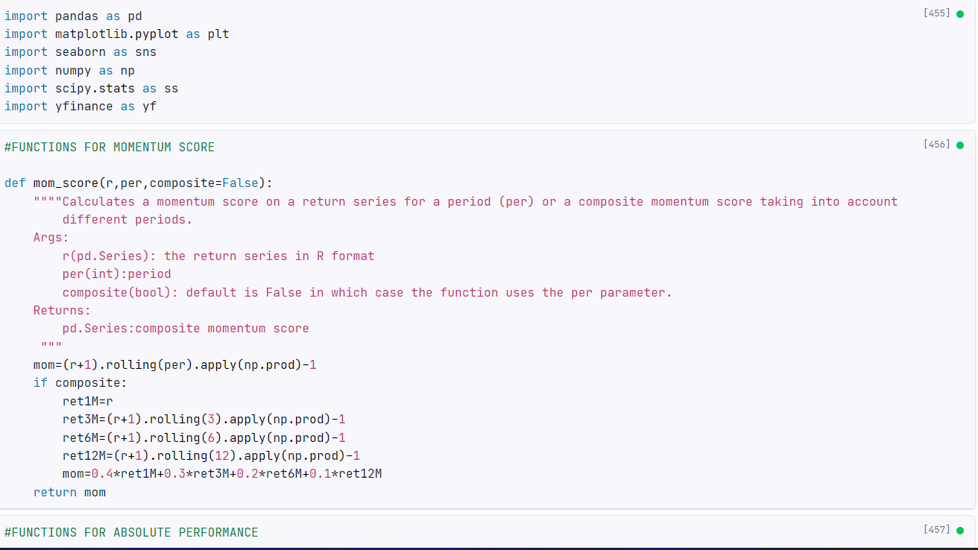
HYPERLINK TO PYTHON CODE
https://app.datacamp.com/workspace/w/449a14d9-82f5-4fa8-9ed3-7a1af644199e/edit?file=notebook.ipynb

Slide 5
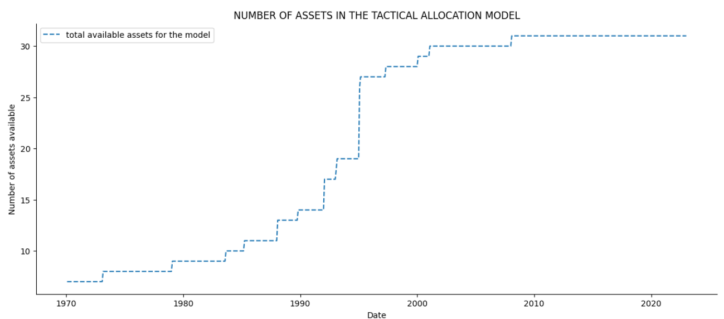
DATA: 31 ASSET CLASSES
The model can pick from assets as datasets become available through time. We start out with 7 asset classes for which we have data starting in 1970 ( US large caps, EAFE, Treasuries, Tbills, Commodities, gold and the dollarindex. We end up with 31 assets as of 2007.

Slide 6
DATA: 31 ASSET CLASSES – RISK/RETURN – RANKED ON MAR
Global all-asset equal-weight: equal weight portfolio of all the assets as they become available in the data-set. Starting with 7 in 1970 and ending with 31 assets as from 2007.
Bench_tr (60/40): 60% US large and mid caps + 40% US Treasuries
US_large: 100% MSCI USA Large and Midcaps
Sharpe ratio: (annualized return asset class– annualized retrurn Tbills)/ volatility asset class
MAR ratio: annualized return asset class/absolute value (maximum drawdown)
 | RETURN (%) | VOL (%) | SHARPE RATIO | MAX DRAWDOWN (%) | MAR RATIO
Global all-assets equal- weight | 9.5% | 9.57% | 0.52 | -39.42% | 0.24
US 60/40 portfolio | 8.38% | 9.63% | 0.4 | -30.7% | 0.27
US large and midcaps | 9.21% | 15.45% | 0.31 | -51.12% | 0.18
*Bloomberg US treasury index data starts from Jan-73. The 60/40 portfolio starts in 1970 as we use T-bill data for the first 3 years instead fo Treasury data.

Slide 7
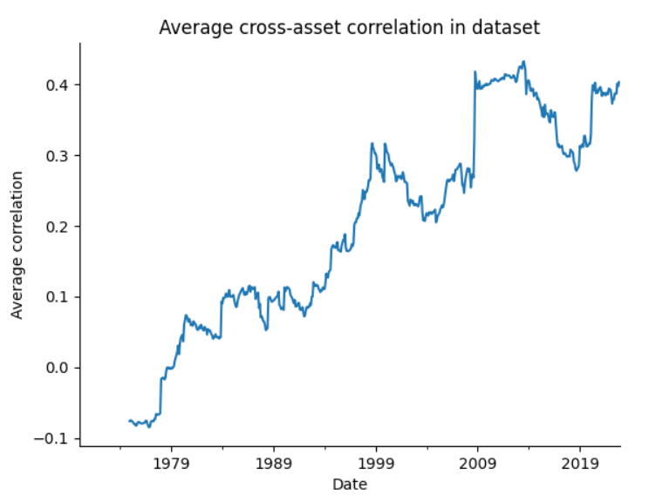
DATA: 31 ASSET CLASSES – RISK/RETURN – RANKED ON MAR

Slide 8
GLOBAL MULTI-ASSET
LONG-ONLY
EQUAL-WEIGHT

Slide 9
THE GLOBAL MULTI-ASSET EQUAL-WEIGHT PORTFOLIO SINCE 1970
Period: Jan 1970 – Dec 2022
Assets: assets are appended as datasets become available through time: starting with 7,ending with 31 assets
.
Systematic rules:
Invest in all assets. Starting with 7 in 1970, ending with 31 assets.
Equal weight.
Rebalance: monthly

Slide 10
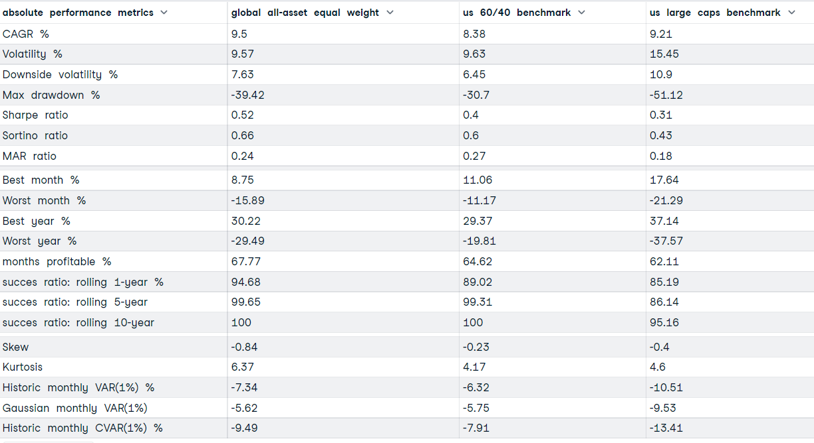
THE GLOBAL MULTI-ASSET EQUAL-WEIGHT PORTFOLIO SINCE 1970

Slide 11
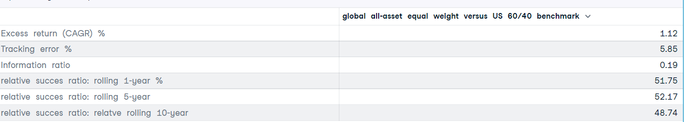
THE GLOBAL MULTI-ASSET EQUAL-WEIGHT PORTFOLIO SINCE 1970
*The success ratio shows the base-rate or the batting-average of a strategy. It shows the percentage of time a strategy is successful:
Absolute success ratio: rolling 5-year: % of all rolling 60-month periods the strategy is positive
Relative success ratio: rolling 5- year: % of all rolling 60-month periods the strategy beats a benchmark

Slide 12
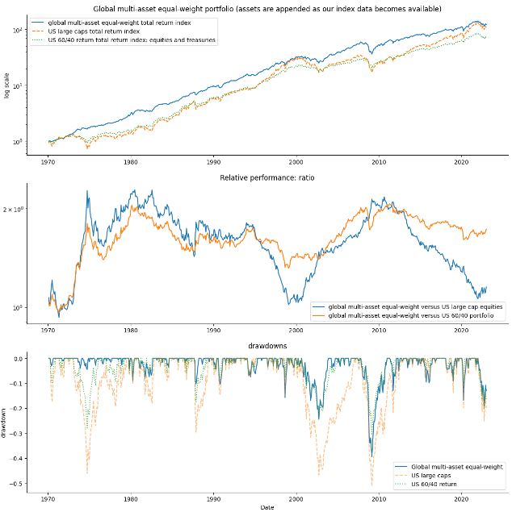
THE GLOBAL MULTI-ASSET EQUAL-WEIGHT PORTFOLIO SINCE 1970
 | RETURN (%) | VOL (%) | SHARPE RATIO | MAX DRAWDOWN (%) | MAR RATIO
Global all-assets equal- weight | 9.5% | 9.57% | 0.52 | -39.42% | 0.24
US 60/40 portfolio | 8.38% | 9.63% | 0.4 | -30.7% | 0.27
US large and midcaps | 9.21% | 15.45% | 0.31 | -51.12% | 0.18

Slide 13
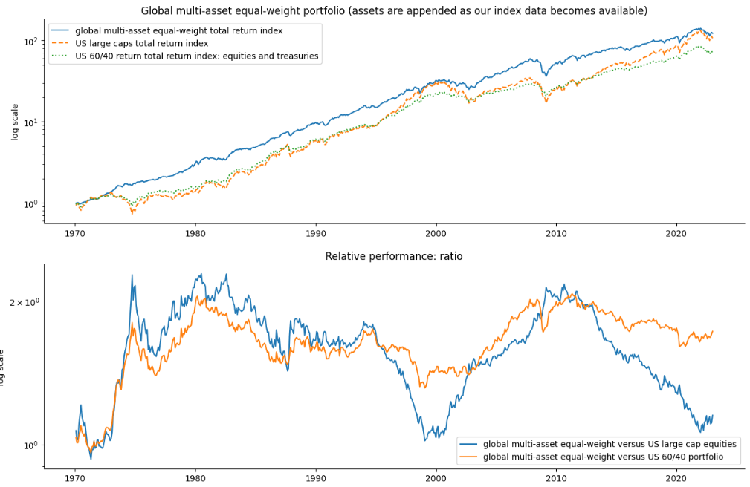
THE GLOBAL MULTI-ASSET EQUAL WEIGHTED PORTFOLIO SINCE 1970

Slide 14
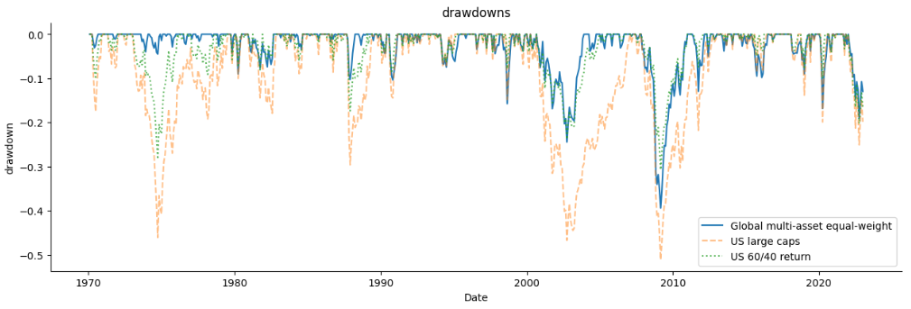
THE GLOBAL MULTI-ASSET EQUAL-WEIGHT PORTFOLIO SINCE 1970

Slide 15
GLOBAL MULTI-ASSET
LONG-ONLY
RELATIVE MOMENTUM
(CROSS-SECTIONAL MOMENTUM)

Slide 16
GLOBAL MULTI-ASSET RELATIVE MOMENTUM MODEL (top 25% - 12m)
Period: Jan 1971 – Dec 2022
Assets: assets are appended as datasets become available through time: starting with 7,ending with 31 assets to pick from.
Systematic rules:
At the end of each month, calculate the momentum-score for all assets. By default, the momentum-score is the return over the past 12 months.
Relative momentum: only invest -at the close of the month- in the top 25% assets with the best momentum-score. Round the number. Equal weights. (e.g.: 3 assets = 33.33% in each asset)
Rebalance: monthly
Transaction cost: 30 bps

Slide 17
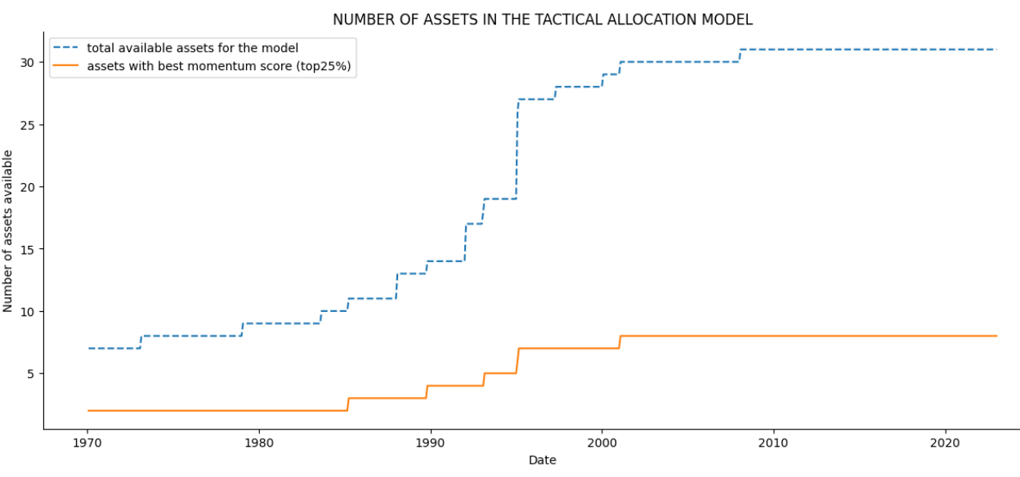
GLOBAL MULTI-ASSET RELATIVE MOMENTUM MODEL (top 25% - 12m)
The model can pick from assets as datasets become available through time. We start out with 7 asset classes for which we have data starting in 1970 ( US large caps, EAFE, Treasuries, T-bills, Commodities, gold and the dollar index. We end up with 31 assets as of 2007.
The relative momentum model picks those assets with the best momentum score. This is the relative momentum filter. We use top25% (rounded). This is the orange line. The orange line shows the number of assets with the best momentum score out of all the available assets at that point in time (blue line). The model starts with 2 top-momentum assets in 1970 and ends up with 8 assets.

Slide 18
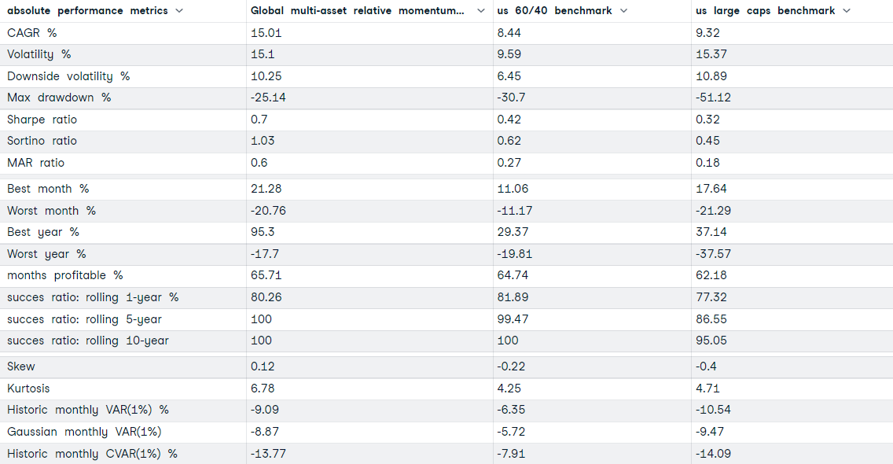
GLOBAL MULTI-ASSET RELATIVE MOMENTUM MODEL (top 25% - 12m)
Average annual turnover Global relative momentum portfolio: 218%

Slide 19
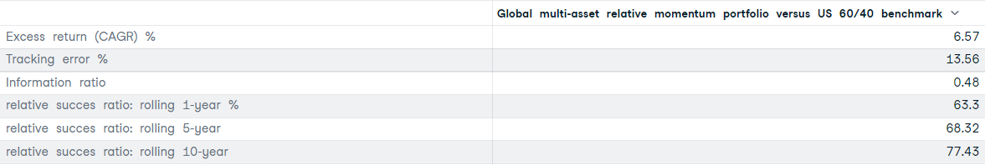
GLOBAL MULTI-ASSET RELATIVE MOMENTUM MODEL (top 25% - 12m)

Slide 20
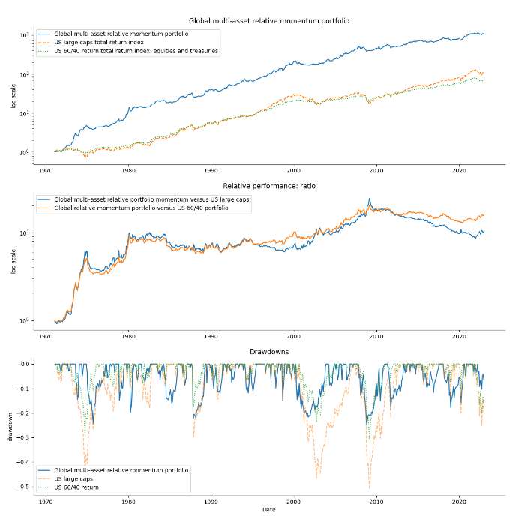
GLOBAL MULTI-ASSET RELATIVE MOMENTUM MODEL (top 25% - 12m)

Slide 21
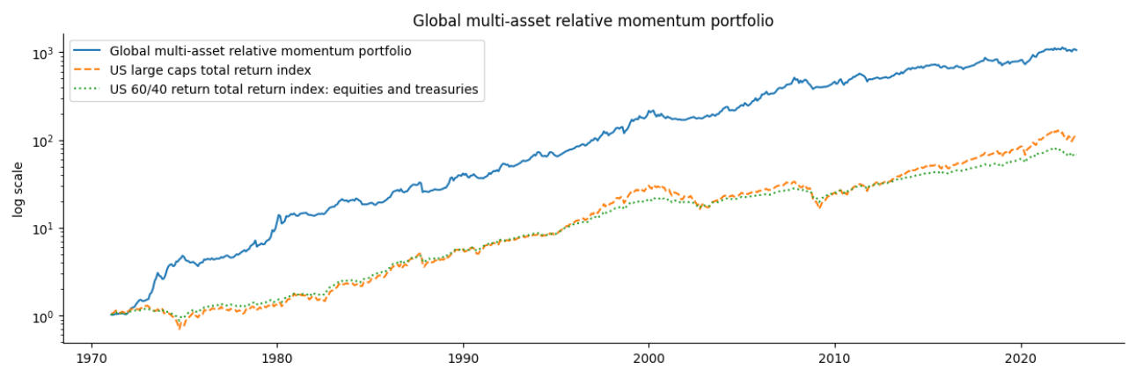
GLOBAL MULTI-ASSET RELATIVE MOMENTUM MODEL (top 25% - 12m)

Slide 22
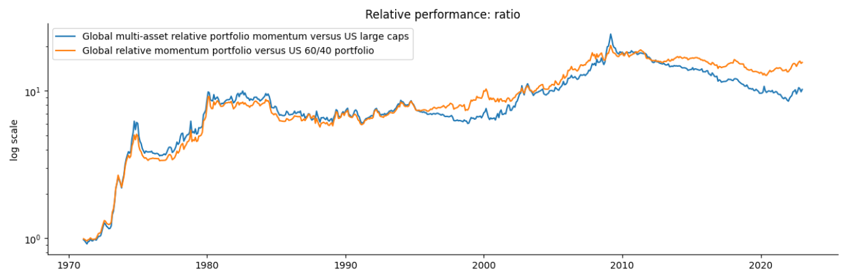
GLOBAL MULTI-ASSET RELATIVE MOMENTUM MODEL (top 25% - 12m)

Slide 23
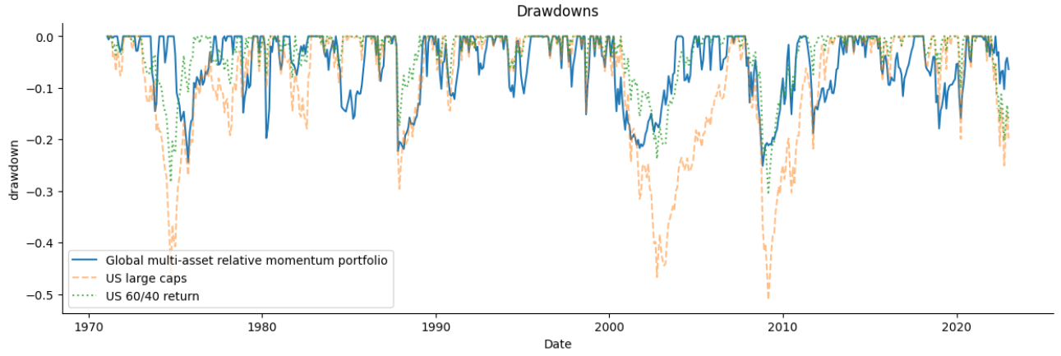
GLOBAL MULTI-ASSET RELATIVE MOMENTUM MODEL (top 25% - 12m)

Slide 24
GLOBAL MULTI-ASSET RELATIVE MOMENTUM MODEL (top 25% - 12m)
Robust parameters?

Slide 25
GLOBAL MULTI-ASSET RELATIVE MOMENTUM MODEL (top 25% - 12m)
Performance metrics look positive, but some important remarks:
This back-test was performed on total return indices. Most long only investors trade indices through ETFs or funds. ETFs/Funds have annual tracking errors, manages fees and dividend taxes. Furthermore, capital gain taxes might be an issue for investors in locations with capital gain taxes for short term profits.
Relative multi-asset momentum looks to gain from:
Longer lookback periods. Investors who can trade at the lowest costs with minimal price-impact could use composite momentum also.
Moderate diversification (not too concentrated, not too diversified).
Relative multi-asset momentum has equity-like risk when measured as vol, downside vol and value at risk. Skew is positive, however.
Transaction costs are extremely important as turnover is high. We modelled 30 bps transaction costs which seems way too expensive for todays standards but too cheap for historical standards. Results remain robust for 50 bps but start worsening very quickly as of 80 bps and higher.
The information ratio of 0.4 looks decent, but there can be long periods of underperformance versus a 60/40 benchmark. Visually, one can notice this in the relative performance charts. Statistically, the relative success ratio shows that 77% of all rolling excess 10-year periods (120 months) were positive. We would have expected this to be higher. Consistency in outperformance is still somewhat an open question here.
Further investigations: We hypothesize that long-only investors might benefit somewhat further when using individual countries instead of regions as we did. Splitting up the commodities part is also a possibility as is adding more currencies.

Slide 26
GLOBAL MULTI-ASSET
LONG-ONLY
ABSOLUTE MOMENTUM
(TREND FOLLOWING – TIME SERIES MOMENTUM)

Slide 27
GLOBAL MULTI-ASSET ABSOLUTE MOMENTUM MODEL (12m)
Period: Jan 1971 – Dec 2022
Assets: assets are appended as datasets become available through time: starting with 7,ending with 31 assets.
Systematic rules:
At the end of each month, calculate the momentum-score for all assets. By default, the momentum-score is the return over the past 12 months.
Absolute momentum:
Only invest -at the close of the month- in assets who have a positive momentum score. Equal weights.Note that – in contrast to relative momentum – the absolute momentum model can be invested in all assets if all trends (momentum score) are positive (e.g.: 31 assets positive trend = 3.23% in each asset).
If momentum score is negative, invest in T-bills (cash)
Rebalance: monthly
Transaction cost: 30 bps

Slide 28
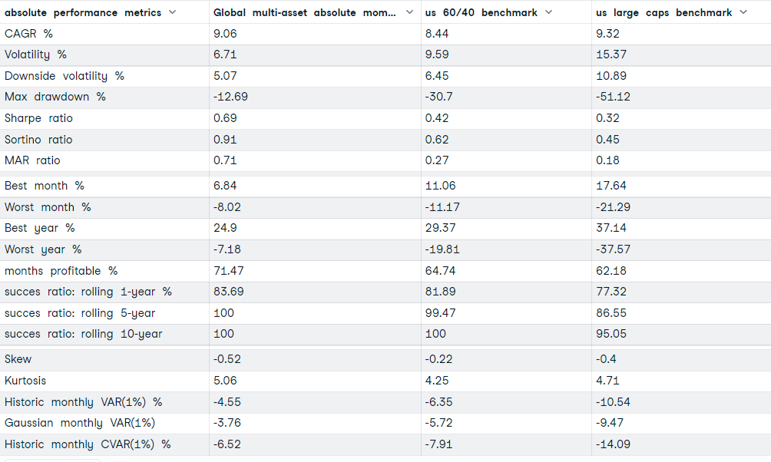
GLOBAL MULTI-ASSET ABSOLUTE MOMENTUM MODEL (12m)
Average annual turnover Global absolute momentum portfolio: 95%

Slide 29
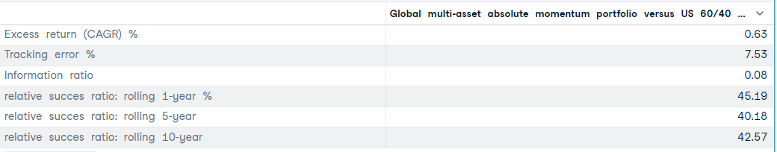
GLOBAL MULTI-ASSET ABSOLUTE MOMENTUM MODEL (12m)

Slide 30
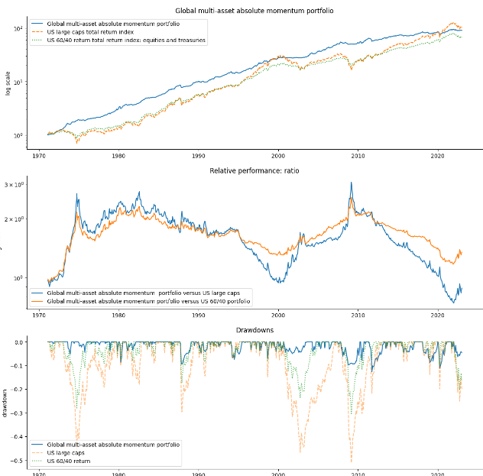
GLOBAL MULTI-ASSET ABSOLUTE MOMENTUM MODEL (12m)

Slide 31
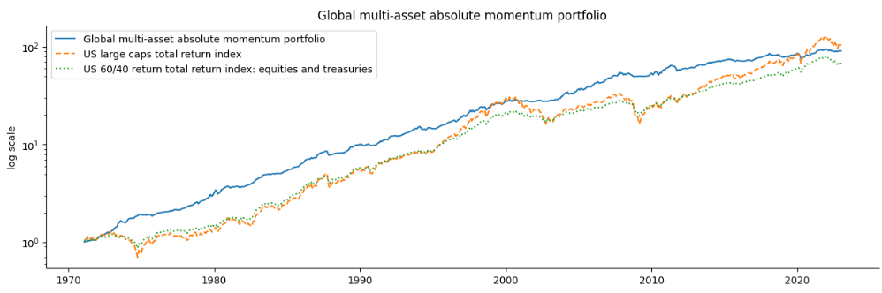
GLOBAL MULTI-ASSET ABSOLUTE MOMENTUM MODEL (12m)

Slide 32
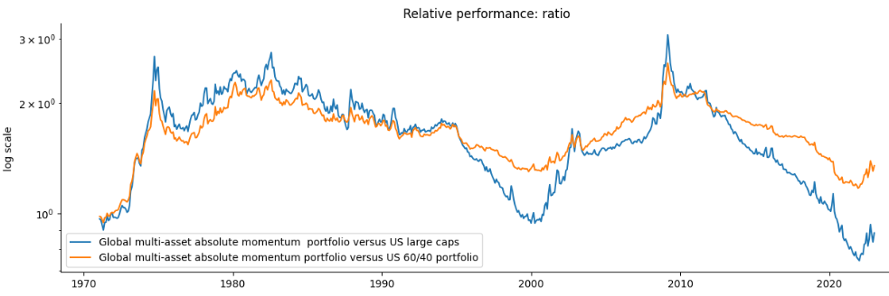
GLOBAL MULTI-ASSET ABSOLUTE MOMENTUM MODEL (12m)

Slide 33
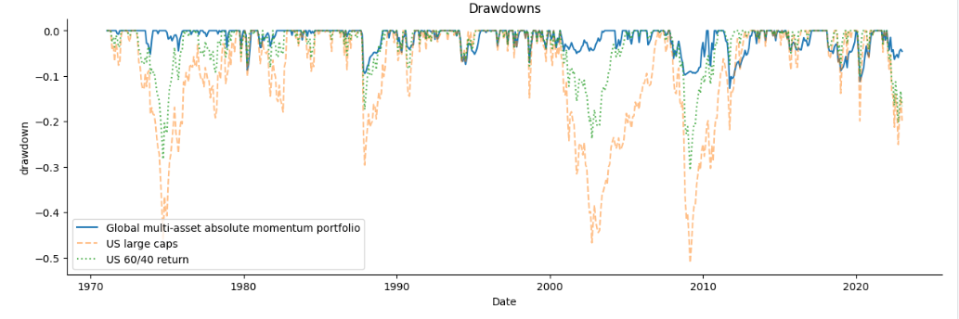
GLOBAL MULTI-ASSET ABSOLUTE MOMENTUM MODEL (12m)

Slide 34
GLOBAL MULTI-ASSET ABSOLUTE MOMENTUM MODEL (12m)
Robust parameters?

Slide 35
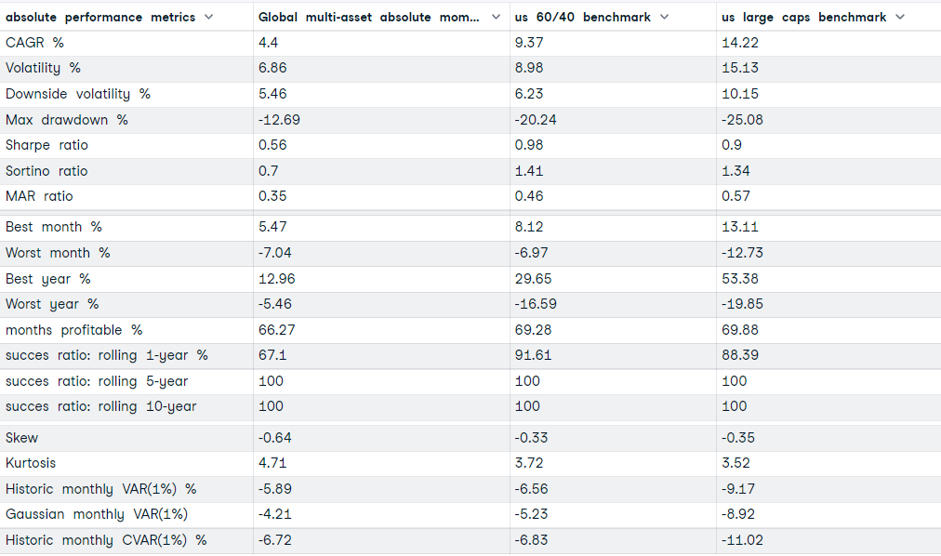
GLOBAL MULTI-ASSET ABSOLUTE MOMENTUM MODEL (12m): SINCE 2009

Slide 36
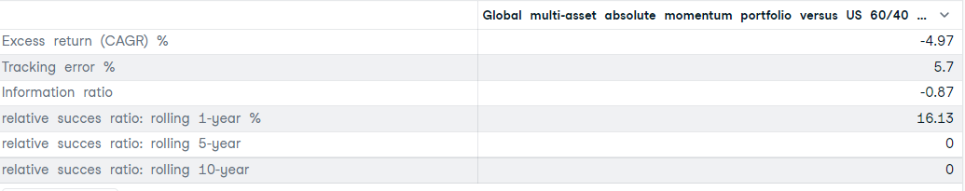
GLOBAL MULTI-ASSET ABSOLUTE MOMENTUM MODEL (12m): SINCE 2009

Slide 37
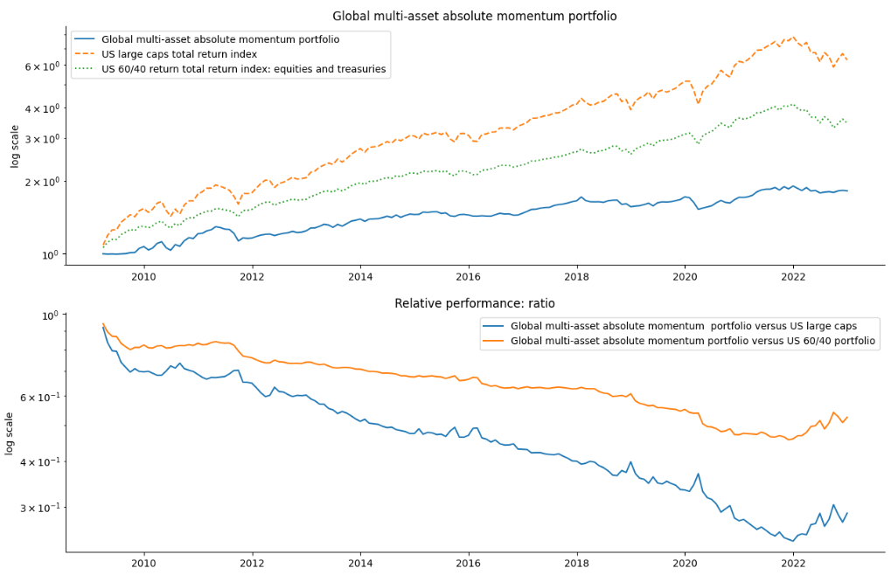
GLOBAL MULTI-ASSET ABSOLUTE MOMENTUM MODEL (12m): SINCE 2009

Slide 38
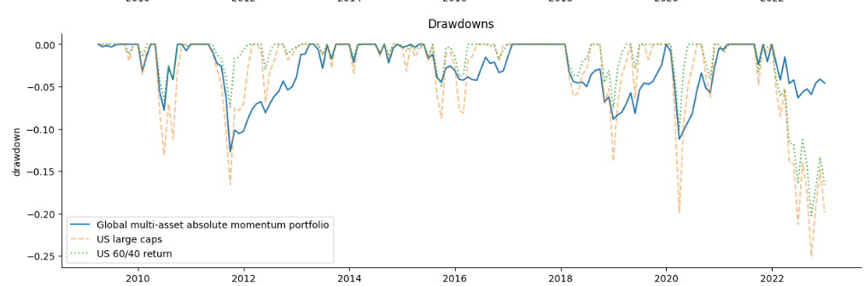
GLOBAL MULTI-ASSET ABSOLUTE MOMENTUM MODEL (12m): SINCE 2009

Slide 39
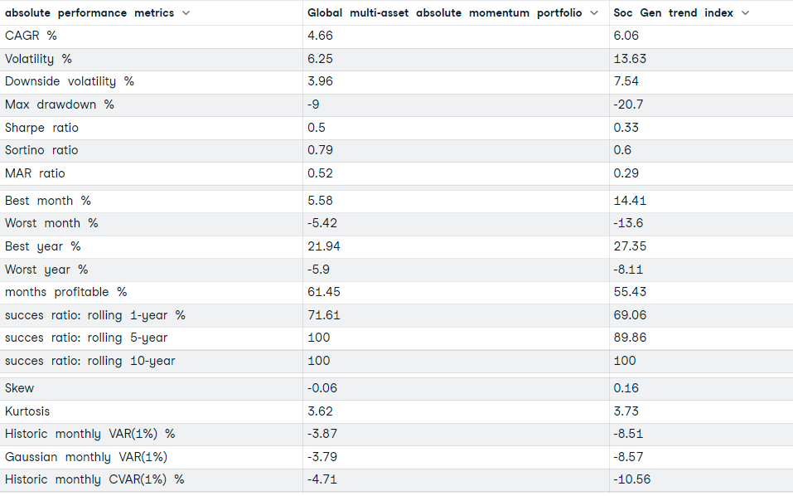
GLOBAL MULTI-ASSET ABSOLUTE MOMENTUM MODEL (12m): SINCE START SOC GEN TREND INDEX Jan 2000

Slide 40
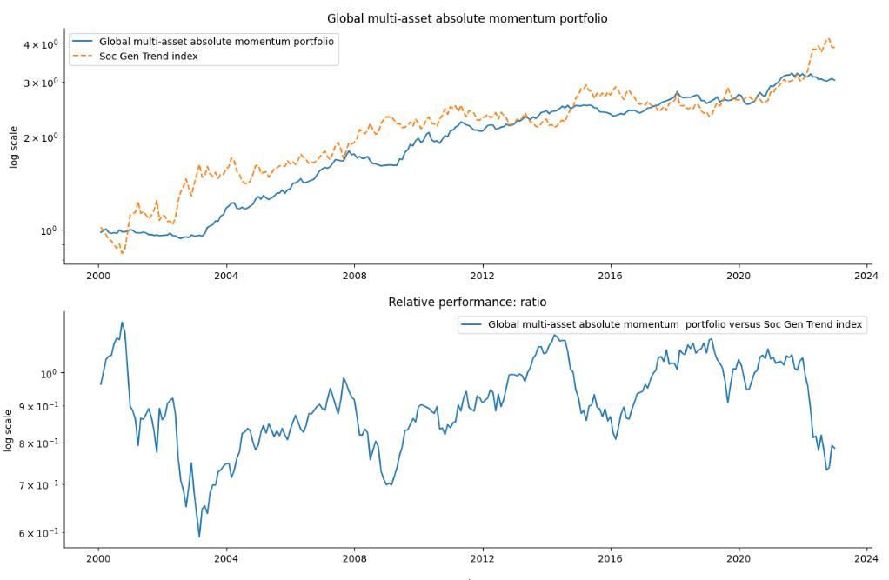
GLOBAL MULTI-ASSET ABSOLUTE MOMENTUM MODEL (12m): SINCE START SOC GEN TREND INDEX Jan 2000

Slide 41
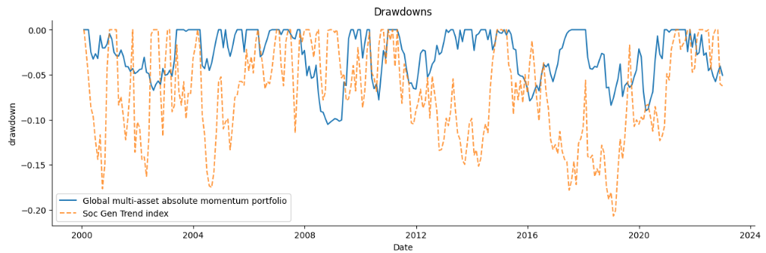
GLOBAL MULTI-ASSET ABSOLUTE MOMENTUM MODEL (12m): SINCE START SOC GEN TREND INDEX Jan 2000

Slide 42
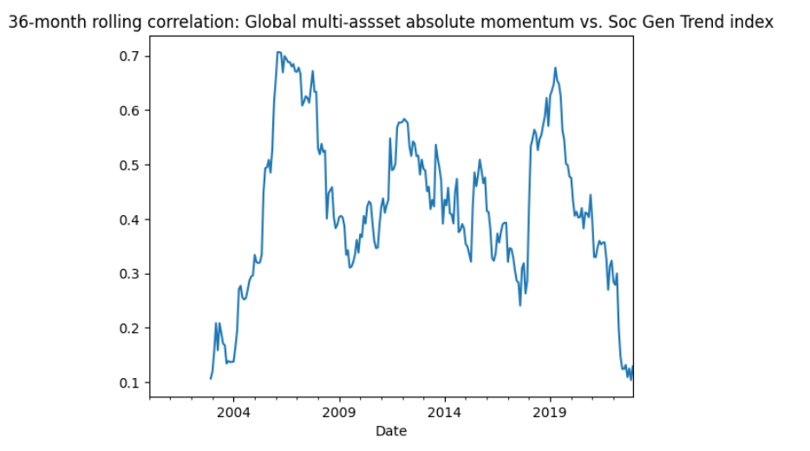
GLOBAL MULTI-ASSET ABSOLUTE MOMENTUM MODEL (12m): SINCE START SOC GEN TREND INDEX Jan 2000

Slide 43
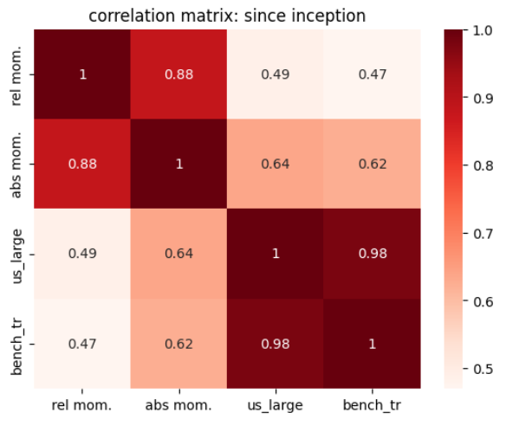
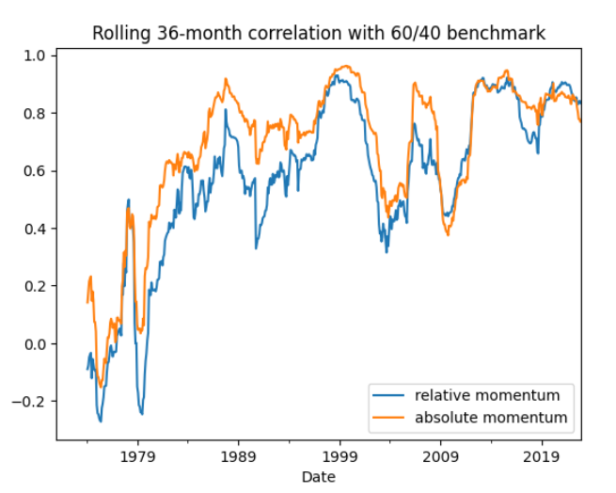
GLOBAL MULTI-ASSET ABSOLUTE MOMENTUM MODEL (12m): CORRELATIONS

Slide 44
GLOBAL MULTI-ASSET ABSOLUTE MOMENTUM MODEL (12m)
Performance metrics look positive, but some important remarks:
This back-test was performed on total return indices. Most long only investors trade indices through ETFs or funds. ETFs/Funds have annual tracking errors, manages fees and dividend taxes. Furthermore, capital gain taxes might be an issue for investors in locations with capital gain taxes for short term profits.
Absolute multi-asset momentum has equity-like returns but with bond-like risks and sometimes less (look at this year). This is not a surprising result as our multi-asset absolute momentum model is nothing but a straight-forward diversified, long-only trend-following model. The long-term positive results of trend-following have been documented repeatedly across and within asset classes and over very long periods of time (>200 years). In our model we see:
Equity like returns of +/- 9%
Very low risk-metrics such as 5% downside vol, -6.5% Cvar and a maximum drawdown of 12.69%.
Very consistent ,low rolling drawdowns through time. That is the main goal of trend-following: avoiding big losses. For 2022, the drawdown has been less than 5%. This is consistent with the results we have seen from the big trend followers out there . Some shops have killed it this year.
Transaction costs are still important, but turnover is less at around 100% average annually. We modelled 30 bps transaction costs.
As always, numbers disguise pain. Trend following has suffered over the past decade. It’s not necessarily so that trend followers have suffered big losses. No, the style continued to offer minimal drawdowns, but failed to deliver the big returns compared to the traditional benchmarks and equities.
Since March 2009, the absolute model delivered 4.4% CAGR versus 9.3% for a US 60/40 benchmark and 14.22% for US large caps. Maximum drawdown remained very low at 12.7%. But even then, the style suffered in risk-adjusted terms. For example, the MAR ratio is 0.35 for absolute momentum compared to 0.46 for the US 60/40 benchmark.
Some trend followers lost a lot of popularity (mostly unjustified) because of return-reasons. However, history proves that the style is so attractive because of lower correlations (especially long/short trend following) and lower drawdowns. This should be the main reason to invest in the trend following style.

Slide 45
GLOBAL MULTI-ASSET ABSOLUTE MOMENTUM MODEL (12m)
Performance metrics look positive, but some important remarks:
It is comforting to see that mere mortal investors can replicate a trend following style somewhat cheaply through the use of long-only ETFs. The straightforward style represented here offered slightly less return compared to the Soc Gen Trend index since start 2000 , but with much lower drawdowns. The Soc Gen Trend index represents the returns for a pool of trend following based hedge fund managers.
Maybe surprisingly, the overall correlation between multi-asset absolute momentum and the Soc Gen Trend index is lowish 0.4 (and fluctuates heavily between 0 and 0.7), suggesting diversification benefits between long-only trend following and more complex long-short futures programs. Big trend-followers diversify even more across futures markets and very often implement a long-short trend following approach.
Further investigations: We hypothesize again that long-only investors might benefit somewhat further when using individual countries instead of regions as we did. Splitting up the commodities part is also a possibility as is adding more currencies. Thematic ETFs might be included as well as thematic classes are prone to sudden trending behavior due to herding. More assets is often better for trend-following programs as it tends to smooth out the overall equity curve. More sophisticated investors should try to include short futures as well to capture heavy downside action in asset classes. The Soc Gen Trend index even provides positive returns during bear markets (2000-2003, 2008, 2022). This is due to the short-leg potential of most of these programs.
Finally, investors should do well in learning from history. Markets might indeed be more mean-reversing in nature, but every now and then they tend to trend heavily. This is when trend followers show their power. It is of no use to try to time the style. Stay invested and consider them core building blocks of a total portfolio. Lots of investors dumped trend followers over the past decade only to watch them explode again recently while their own portfolios bleed heavily. No doubt, the style will become hot again (marketing departments must be turning over hours these days for trend followers. The cycle will repeat itself.
Investors often wonder how to best hedge their portfolios. Trend following core programs should be the first choice. Always. Option hedging is too expensive to implement consistently, futures beta-hedging requires exact market timing and other popular risk-off asset classes such as Treasuries, gold and the dollar might surprise negatively in equity bear markets as well (2022 is an excellent example). Trend following programs could be held through time with minimal bleed in non-trending markets. All that is required is patience…

Slide 46
GLOBAL MULTI-ASSET
LONG-ONLY
DUAL MOMENTUM

Slide 47
GLOBAL MULTI-ASSET DUAL MOMENTUM MODEL (top25% - 12m)
Period: Jan 1971 – Dec 2022
Assets: assets are appended as datasets become available through time: starting with 7,ending with 31 assets.
Systematic rules:
At the end of each month, calculate the momentum-score for all assets. By default, the momentum-score is the return over the past 12 months.
Relative momentum + Absolute momentum
Invest in the top 25% assets, only if the momentum-score is positive.
If top momentum-score is negative, switch the top momentum asset into T-bills (cash)
Rebalance: monthly
Transaction cost: 30 bps

Slide 48
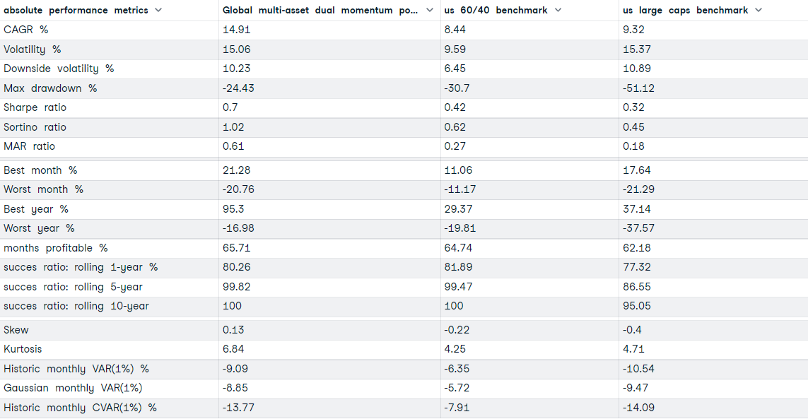
GLOBAL MULTI-ASSET DUAL MOMENTUM MODEL (top25% - 12m)
Average annual turnover Global dual momentum portfolio: 213%

Slide 49
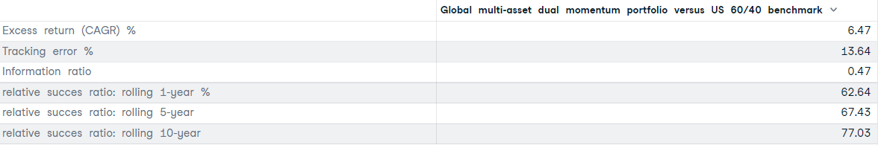
GLOBAL MULTI-ASSET DUAL MOMENTUM MODEL (top25% - 12m)

Slide 50
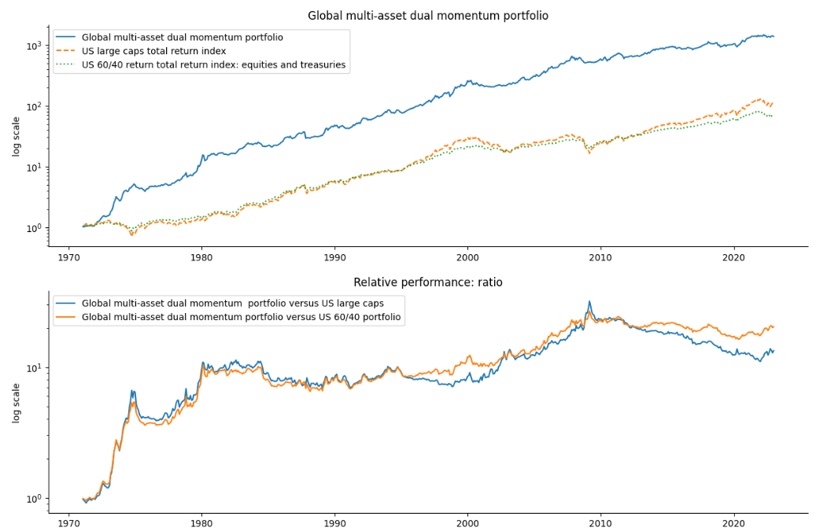
GLOBAL MULTI-ASSET DUAL MOMENTUM MODEL (top25% - 12m)

Slide 51
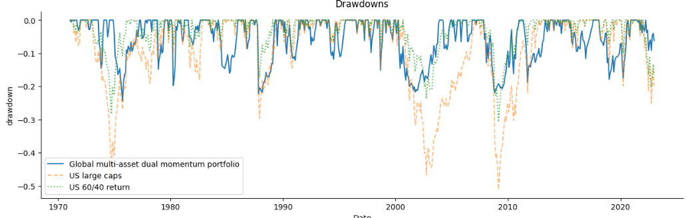
GLOBAL MULTI-ASSET DUAL MOMENTUM MODEL (top25% - 12m)

Slide 52
GLOBAL MULTI-ASSET DUAL MOMENTUM MODEL (top25% - 12m)
Results look good once again. But maybe surprisingly, we find no extra benefit from dual momentum versus relative momentum-only
Dual momentum has about the same returns and risk-adjusted metrics as relative momentum. Dual momentum did not provide extra cushion on the downside versus relative momentum only. Why is this?
Our relative momentum model can already pick from risk-off assets such as treasuries, T-bills, gold, dollar index, trend,…Overlaying a trend filter through absolute momentum did not provide benefits in this case. Extra trend filters - when risk-off assets are already in place (in the relative model) - can lead to more whipsaw transactions.
Top ranked momentum assets are often the most volatile assets. The momentum score is somewhat less stable for high performers compared to for example more stable performers which have positive momentum but not the top-momentum. The more volatile momentum score of top-momentum assets can once again lead to more whipsaw transactions when an extra trend filter is used on relative momentum.
In defense of dual momentum:
The original concept – popularized in the paper by Mr. Gary Antonucci – is more straightforward in nature using only a few broad asset classes. Mr. Antonacci himself pointed to the fact that using more asset classes (sectors instead of one big equity benchmark for example) can lead to higher volatility and loss of diversification benefits for relative momentum.
Lots of other studies do find extra benefit from using dual momentum with lots of asset classes. One paper we liked for example is The Trend is Our Friend: Risk Parity, Momentum and Trend Following in Global Asset Allocation which also uses volatility-adjusted momentum.
Clare, Andrew D. and Seaton, James and Smith, Peter N. and Thomas, Stephen H., The Trend is Our Friend: Risk Parity, Momentum and Trend Following in Global Asset Allocation (July 31st, 2015). Available at SSRN: https://ssrn.com/abstract=2126478 or http://dx.doi.org/10.2139/ssrn.2126478

